Slide 1

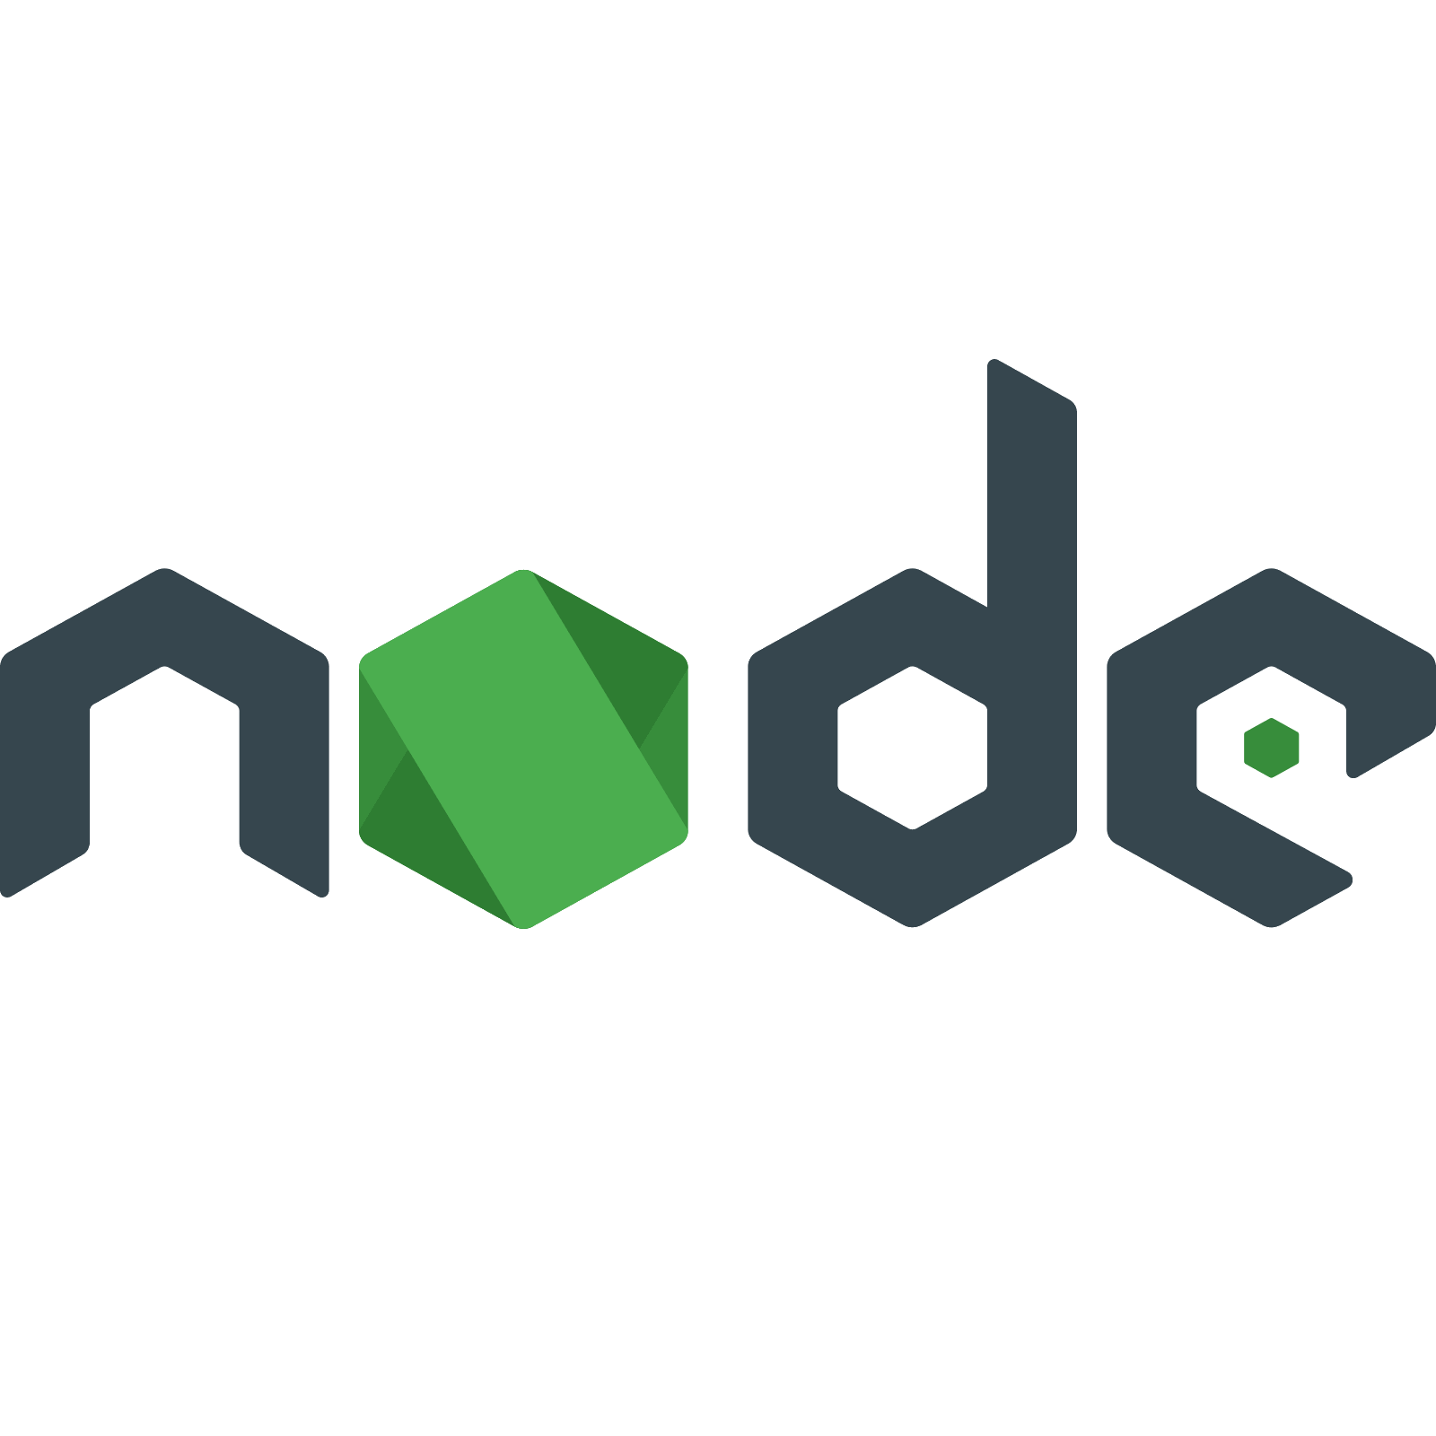
What
Is Node?
Server Side Development / Web Programming
JavaScript
I thought that was client side.

Slide 2

Node
Server Side Development / Web Programming
Advantages
Open Source Platform for running JavaScript outside of a browsers
Highly-Scalable, data-intensive and real-time apps
Largest Ecosystem of Open Source Libraries
It is often used to build RESTful APIs

Slide 3



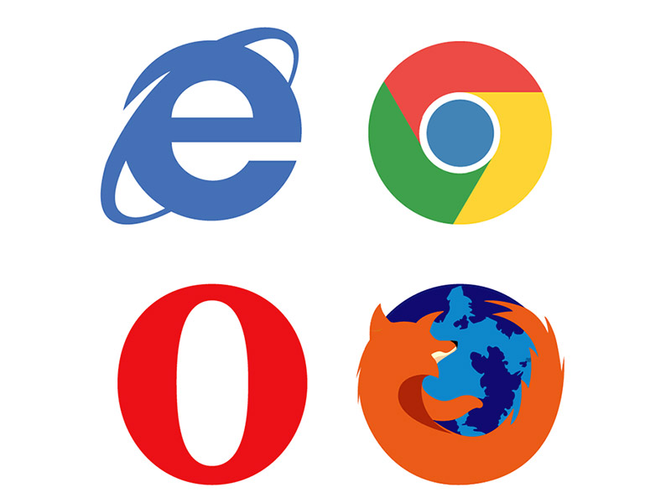


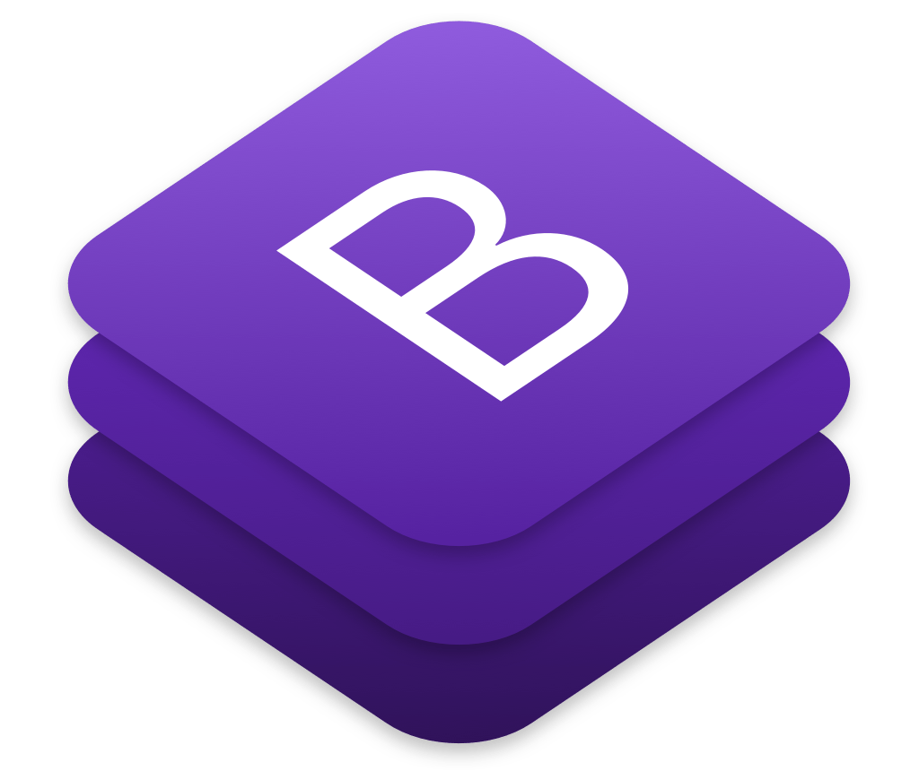
RESTful API vs Standard Website
Server Side Development / Web Programming
Node.js
Node.js
Server Side
MongoDB, Express, Node.js
Express.js
Mongodb
PUG
Express.js
Mongodb
JSON
HTML, CSS & JavaScript Page
Client Side
HTML, CSS, JavaScript
React
Mobile App
Browser
Client Side Website
Android & iOS
Android & iOS
Bootstrap
Open Source

Slide 4








Who uses Node?
Server Side Development / Web Programming

Slide 5


PayPal Node
Server Side Development / Web Programming
Converting to Node
Built twice as fast
33% fewer lines of code
40% fewer files
2x requests/sec
Increase response time by 35%

